Slide 1


Holistic Review and Graduate Admissions
Dr. Julie Posselt
University of Southern California
posselt@usc.edu
@JuliePosselt
This material is based upon work supported by the National Science Foundation under Grant Nos. 1633275, 1649297, 1807047, 1834528, and 1834516. Any opinions, findings, and conclusions or recommendations expressed in this material are those of the author(s) and do not necessarily reflect the views of the NSF.

Slide 2










Leveraging professional societies’ reach and influence
Leveraging the power of peer-to-peer faculty development
Berkeley | Irvine | USC | UCLA | UCSB | Davis
Col. Natural Resources | DECADE Mentors | Physics | Physics | Physics | Chemistry
Mechanical Engineering | College of Engineering | Chemistry | Mechanical Engineering | Chemical Engineering | Mat Sci & Engineering
Bioeng | Math | Molecular Biology | Ecology & Evol Biology | Molec, Cell, Dev Biology | Biochem, Molec, Cell, Dev Biology
Civil/Envir Eng | Computer Science | Psychology | Atmos & Ocean Sci | Envir Sci | Ecology

Slide 3
Common Practices in Doctoral Admissions

Slide 4

Inside Graduate Admissions
Research Questions:
How do faculty individually judge & collectively select applicants to highly ranked Ph.D. programs?
What assumptions about merit guide faculty judgment?
How do disciplinary norms shape faculty judgment?
Comparative ethnographic case study:
10 highly ranked PhD programs in 9 fields and 3 public & private universities
85 interviews with professors & a few graduate students
22 hours of admissions meeting observations in six of the programs
Copyright 2018, JRP & CWM
Posselt (2016)
Notes:
Goal: See admissions from decision makers’ point of view, and understand how and why they come to decisions that don’t always reflect widely-shared commitments to diversity.

Slide 5
Programs Studied
 | Humanities | Social Sciences | Natural Sciences
High Consensus | Philosophy (2 programs) | Economics | Physics
Moderate Consensus | Classics | Sociology | Astrophysics
Low Consensus | Linguistics | Political Science | Biology

Slide 6
Ambivalence to Change
Evaluative cultures explain tensions between how we define merit & value diversity.
Admissions Criteria
Disciplinary Cultures
Admissions Processes
Notes:
Ambivalence about organizational change, especially reforms related to diversity & equity, which require confronting– and maybe even talking about -- race, gender, and systems of inequality.

Slide 7
Multi-tiered Review
 | Initial Screening | Short List
Conceptualizing merit | Conventional achievers with low perceived risk of attrition | Future of the discipline
Important criteria | “Numbers” in context of undergraduate prestige & curriculum rigor | Experience and dispositions for research; Unique perspective; Research interests align
Relationship of merit & diversity | Merit may be in tension with racial/gender diversity aims. | Diversity is a component of merit.

Slide 8
Problems with the Typical Process
Undisciplined review allows implicit biases to impact judgment
Overreliance on metrics without considering context
Limited efficacy of initial filters that limit access to certain groups

Slide 9
Undisciplined review allows implicit biases to impact judgment
Notes:
...populations that programs say they want
......populations at risk in the US
......populations critical to future of labor market

Slide 10
Astrophysics Admissions Committee
 | Prabhat | Jeff | Juan | Wayne | Chris
Title | Assoc Prof | Assoc Prof | Assoc Prof | Asst Prof | Ph.D. candidate
Training | Ivy League | Ivy League | Ivy League | Big Ten | Big Ten
National Origin | Int’l | Domestic | Int’l | Domestic | Domestic

Slide 11
Juan:
Prabhat:
Wayne:
Juan:
Chris:
Juan:
Is it enough to be a woman in science?
[Discussion of how different perspectives might affect the community.]
Lisa said she wants to be a role model because she never received explicit encouragement until recently. She wrote about the importance of providing active support, not just the absence of discrimination.
Shawna says she needs to develop self-confidence and overcome self-doubt.
And then there’s Amy, who claimed to experience teasing and bigotry from her peers and a high school science teacher. She went to an all-women’s college so she could still study science.
I’m less persuaded by that story. Maybe the teacher was young and inexperienced in handling high school boys. She might come to the program with an axe to grind.
Either way, now she’s taking action, organizing a lecture series on women in science... We need to read between the lines on these things.
Person eventually nominated had started an astronomy outreach program and had letters of recommendation from familiar names

Slide 12
He grew up in a yurt in the Himalayas, was raised by his mom and grandma after his father died at an early age, and the next neighbors were two mountains over. He then found his way to a major U.S. public research university and has since started the only organization for the discipline in the Himalayan region.
But do we think he can succeed?
[long pause]
He’s the most amazing case we’ve ever seen.
He would bring some personality to the department. I commit to look after him and fund him through the prelims…. He presents himself as quite intelligent.”
Excellent idea to give him a chance.
Student ultimately admitted and enrolled.
Prabhat:
Jeff:
Prabhat:
George:
Chris:

Slide 13
Overreliance on metrics without considering context & error.
Notes:
...populations that programs say they want
......populations at risk in the US
......populations critical to future of labor market

Slide 14
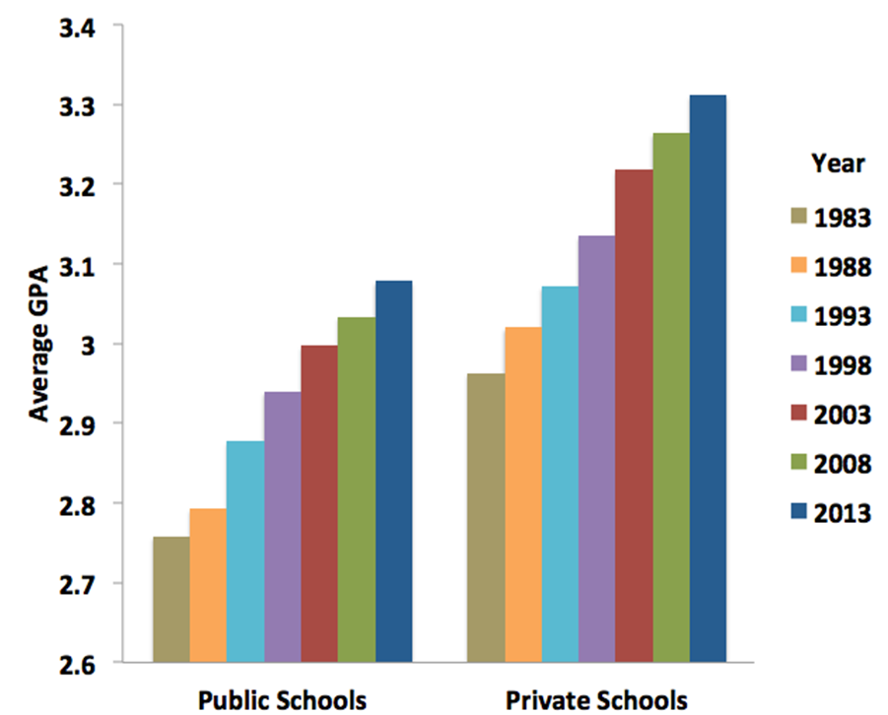
Grade Inflation
Patterns of grade inflation undermine opportunities for minority participation.
Copyright 2018, JRP & CWM
gradeinflation.com

Slide 15
Most STEM URMs Attend Public Colleges (Red = Private)
Rank | Engineering | Physical Sci | Bio/Biomed | Math/Stats | Social Sciences Bachelor’s | Education Bachelor’s
1 | Florida International Univ | Florida International Univ | Florida International Univ | The Univ of Texas at Austin | UC-Los Angeles | Ashford Univ
2 | Univ of Central Florida | The Univ of Texas at Austin | Univ of Texas Rio Grande Valley | UC-Riverside | Florida International Univ | Grand Canyon Univ
3 | Texas A & M Univ-College Station | Univ of Houston | The Univ of Texas at Austin | Univ of Texas Rio Grande Valley | CSU-Northridge | Florida International Univ
4 | Univ of Florida | Univ of Florida | Univ of South Florida | CSU-San Bernardino | UC-Riverside | Univ of Central Florida
5 | Georgia Institute of Technology | Xavier Univ of Louisiana | The Univ of Texas at El Paso | Univ of Houston | CSU-Los Angeles | Univ of Texas at San Antonio
6 | The Univ of Texas at El Paso | Univ of Texas Rio Grande Valley | Univ of Florida | UC-Los Angeles | Florida State Univ | CSU-Fullerton
7 | Cal State Polytechnic Univ-Pomona | UC-Santa Cruz | UC-Davis | UC-Santa Barbara | UC-Irvine | Univ of New Mexico
8 | The Univ of Texas at Austin | The Univ of Texas at El Paso | Univ of Central Florida | Cal State Poly. Univ-Pomona | CSU-Long Beach | CSU-Northridge
9 | CSU-Long Beach | Texas A & M Univ-College Station | Florida State Univ | The Univ of Texas at San Antonio | UC-Santa Barbara | Georgia State Univ
10 | Arizona State Univ-Tempe | CSU-San Bernardino | Univ of Arizona | San Diego State Univ | Univ of South Florida | The Univ of Texas at El Paso
11 | The Univ of Texas Rio Grande Valley | UC-San Diego | UC-San Diego | UC-Berkeley | CSU-Fresno | S. Illinois Univ-Carbondale
12 | The Univ of Texas at San Antonio | United States Naval Academy | Texas A & M Univ-College Station | The Univ of Texas at El Paso | Univ of Maryland-College Park | CSU-Los Angeles
13 | Cal Poly. State Univ-San Luis Obispo | Georgia State Univ | UC-Los Angeles | UC-San Diego | Univ of Florida | Jackson State Univ
14 | UC-San Diego | The Univ of Texas at San Antonio | UC-Riverside | CSU-Long Beach | CUNY John Jay Col. of Criminal Justice | Arizona State Univ-Tempe
15 | Texas Tech Univ | UC-Irvine | Florida Atlantic Univ | Texas A & M Univ-College Station | The Univ of Texas at Austin | Western Governors Univ
16 | New Jersey Institute of Technology | Cal State Poly. Univ-Pomona | UC-Santa Cruz | Florida State Univ | San Diego State Univ | CSU-Sacramento
17 | North Carolina A & T State Univ | UC-Santa Barbara | Arizona State Univ-Tempe | Univ of Florida | Georgia State Univ | Northern Arizona Univ
18 | Univ of Houston | Virginia Commonwealth Univ | The Univ of Texas at San Antonio | Stony Brook Univ | UC-Berkeley | Florida Atlantic Univ
19 | UC-Irvine | Univ of Arizona | Georgia State Univ | CUNY City College | UC-Davis | New Mexico State Univ
20 | North Carolina State Univ at Raleigh | UC-Los Angeles | Univ of New Mexico | SUNY at Albany | CUNY Lehman College | UC-Irvine
21 | San Diego State Univ | Pennsylvania State Univ | Rutgers Univ-New Brunswick | Arizona State Univ-Tempe | CSU-Fullerton | Univ of South Florida
22 | San Jose State Univ | UC-Riverside | Univ of Illinois at Chicago | Florida International Univ | UC-Santa Cruz | CUNY Brooklyn College
23 | UC-Davis | UC-Davis | Univ of North Texas | Univ North Carolina at Charlotte | CSU-Sacramento | Liberty Univ
24 | Virginia Polytechnic Inst. and State Univ | Florida State Univ | The Univ of Texas at Arlington | Montclair State Univ | CSU-San Bernardino | Miami Dade College
25 | UC-Riverside | Univ of South Florida | UC-Irvine | Kean Univ | CUNY Queens College | Old Dominion Univ
Copyright 2018, JRP & CWM
Source: IPEDS
Notes:
Most URMs are from institutions where grade inflation is lowest.
Secondary: these are places to do recruitment.
2015-2017
These rankings are based on the average number of completions from three years.

Slide 16
"Factors that can influence performance on the GRE General test 2006-2007“ ETS
166
75%
155
148
GRE Quantitative Scores (2006-2007)
Physical Sciences, US Citizens
25%
144
50%
140
Other Hispanic
N = 393
Mexican Am.
N = 398
Puerto Rican
N = 260
Asian Am.
N =1474
White
N = 14957
Native Am.
N = 90
African Am.
N = 1055
Men
N = 12492
Women
N = 7104
Copyright 2018, JRP & CWM
Source: ETS

Slide 17
GRE Quantitative Score (2006-2007)

Slide 18
GRE Quantitative Score (2006-2007)

Slide 19
GRE Quantitative Score (2006-2007)
Notes:
All fields….

Slide 20
Mean SAT Math Score
Total Group Profile Report, College Board, 2009 College-Bound Seniors.

Slide 21
Average Mathematics Scale Scores, 2007
Asian
White
Afr. Am.
Hispanic
Am. Ind.
The Nation’s Report Card: Mathematics 2009 (NCES 2010-451), National Center for Education Statistics
Notes:
Find poverty rate vs race

Slide 22
Percent NOT living in poverty
Asian
White
Afr. Am.
Hispanic
Am. Ind.
U.S. Bureau of the Census, Income, Poverty, and Health Insurance Coverage in the United States: 2010, Report P60.
Notes:
Find poverty rate vs race
SOURCE: U.S. Bureau of the Census, Income, Poverty, and Health Insurance Coverage in the United States: 2010, Report P60, n. 238, Table B-2, pp. 68-73.; http://www.npc.umich.edu/poverty/#4

Slide 23
Limited Efficacy of the Current Approach

Slide 24
What does the literature say?
Meta-analyses differ in conclusions about the GRE’s validity.
  Morrison & Morrison, 1995;
  Kuncel, et al., 2001;
  Kuncel & Hezlett, 2010
  Orlando, 2005
Why?
  Studies draw upon different methods, different disciplinary and institutional contexts, and different populations.
  Only a few correct for attenuation bias;
  ETS continues to revise the test.
Notes:
Explain reasons for the variation in the results of meta-analyses
John Orlando. ‘The reliability of GRE Scores in Predicting Graduate School Success: A
Meta-Analytic, Cross-Functional, Regressive, Unilateral, Post-Kantian, Hyper-Empirical,
Quadruple Blind, Verbiage-Intensive and Hemorrhoid-Inducing Study.’ Magazine
Ubiquity, vol. 2005 (June).
Morrison, T. & Morrison, M. (1995). ‘A Meta-Analytic Assessment of the Predictive
Validity of the Quantitative and Verbal Components of the Graduate Record
Examination with Graduate Grade Point Averages Representing the Criterion of the
Graduate Success.’ Educational and Psychological Measurement, Vol 55 (no.2): 309-
316.
Melissa L. Dore. 2017. Factors in the Admissions Process Influencing Persistence in a Master’s of Science Program in Marine Science. Doctoral dissertation. Nova Southeastern University. Retrieved from NSUWorks, Abraham S. Fischler College of Education. (110)
http://nsuworks.nova.edu/fse_etd/110.
Moneta-Koehler L, Brown AM, Petrie KA, Evans BJ, Chalkley R (2017) The Limitations of the GRE in Predicting Success in Biomedical Graduate School. PLoS ONE 12(1): e0166742. https://doi.org/10.1371/journal.pone.0166742
Hall JD, O’Connell AB, Cook JG (2017) Predictors of Student Productivity in Biomedical Graduate School Applications. PLoS ONE 12(1): e0169121. https://doi.org/10.1371/journal.pone.0169121

Slide 25
What do we know?
No true validity study exists: denied students aren’t studied.
Correlations vary by exam and outcome (Kuncel & Hezlett, 2007).
Weaker validity with time between testing and outcomes.
Discipline-specific studies: confirm relationships with first year grad school GPA, but not with later outcomes, race, or gender
  Psychology: Sternberg & Williams (1997)
  Marine Sciences: Dore, 2017
  Biomedical Sciences: Moneta-Koehler, et al., 2017; Hall et al., 2017
  Physics: Miller et al., 2019
Notes:
Explain reasons for the variation in the results of meta-analyses
John Orlando. ‘The reliability of GRE Scores in Predicting Graduate School Success: A
Meta-Analytic, Cross-Functional, Regressive, Unilateral, Post-Kantian, Hyper-Empirical,
Quadruple Blind, Verbiage-Intensive and Hemorrhoid-Inducing Study.’ Magazine
Ubiquity, vol. 2005 (June).
Morrison, T. & Morrison, M. (1995). ‘A Meta-Analytic Assessment of the Predictive
Validity of the Quantitative and Verbal Components of the Graduate Record
Examination with Graduate Grade Point Averages Representing the Criterion of the
Graduate Success.’ Educational and Psychological Measurement, Vol 55 (no.2): 309-
316.
Melissa L. Dore. 2017. Factors in the Admissions Process Influencing Persistence in a Master’s of Science Program in Marine Science. Doctoral dissertation. Nova Southeastern University. Retrieved from NSUWorks, Abraham S. Fischler College of Education. (110)
http://nsuworks.nova.edu/fse_etd/110.
Moneta-Koehler L, Brown AM, Petrie KA, Evans BJ, Chalkley R (2017) The Limitations of the GRE in Predicting Success in Biomedical Graduate School. PLoS ONE 12(1): e0166742. https://doi.org/10.1371/journal.pone.0166742
Hall JD, O’Connell AB, Cook JG (2017) Predictors of Student Productivity in Biomedical Graduate School Applications. PLoS ONE 12(1): e0169121. https://doi.org/10.1371/journal.pone.0169121

Slide 26
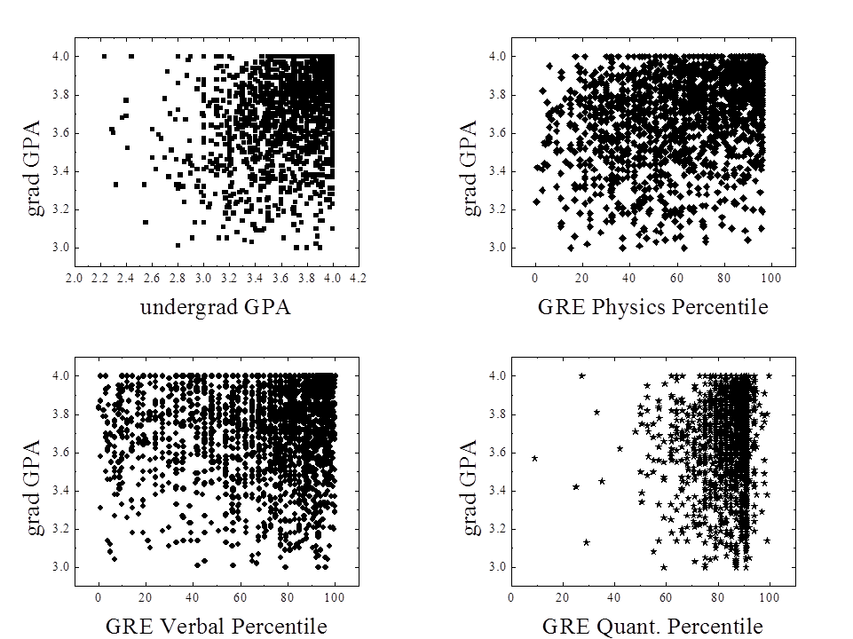
Disciplinary Study: Physics
Analyses supplemental to Miller et al. (2019)

Slide 27
What makes #GRExit different than the undergraduate test-optional movement?
Grad schools & programs tend to center equity & diversity in the motivations, design, and implementation of policy
  Often dropping the GRE is part of a multidimensional effort to advance equity.
Undergrad institutions’ test-optional policies are often
  At least as focused on raising selectivity
  inconsistently integrated into broader enrollment management strategy
  (e.g., U of Chicago drops SAT requirement, but cost of attendance tops $100k/year)

Slide 28

“But what about our ranking?”
Example from astronomy:
  Coordinated, mutual disarmament by top programs
  Vocal support from disciplinary societies

Slide 29
A Framework for Holistic Review

Slide 30
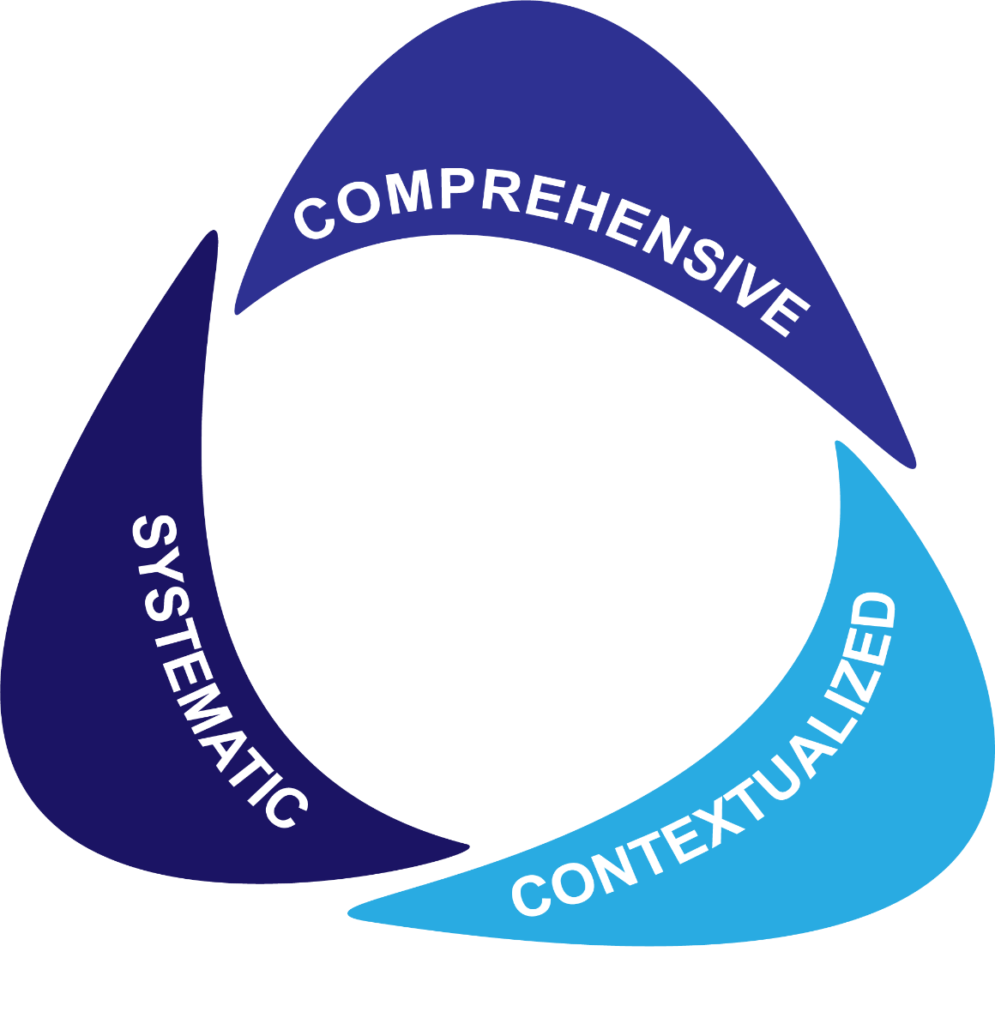
A Framework for Holistic Review
Equity-minded holistic review is needed from the start of the process.

Slide 31
Holistic Review
Academic Preparation
Scholarly Potential
Alignment with Program
Diversity Considerations
Non-Cognitive Competencies
Comprehensive
Numerous and diverse criteria to consider the whole person and their potential
Notes:
Rubric examples
https://docs.google.com/spreadsheets/d/1LOXEdv8C2crzOFCf5B0fQOsEufiSs9mxfvqhjLGuYEI/edit?usp=sharing

Slide 32

Holistic Review
Metrics in context
  Note intrinsic error
  Note societal patterns
Achievements in context
  Distributions of opportunities relative to societal patterns
  Achievements don’t reliably signal aptitude or ability
Students in context
  Alignment with program’s identity, mission, and other goals
Contextualized

Slide 33

Holistic Review
Base review on shared, predefined criteria with structured protocols, for efficiency & consistency.
Create space for flexibility, nuance.
Build in safeguards & checks to promote equity and limit biases.
Carefully select & train gatekeepers
Coordinate evaluation with recruitment and yield efforts
Systematic

Slide 34
Rubrics: Comprehensive, Contextualized, & Systematic
Category | High | Medium | Low | Notes
Academic Preparation | A- or better in all core STEM courses AND B or better in non-STEM courses; received at least one academic honor | B or better in all core STEM courses; Concerning grades have a reasonable explanation | Lower than a B in 2 or more core STEM courses; Grades of C or lower do not have a reasonable explanation
Scholarly potential | Clear commitment to and enthusiasm for research AND experience at least equal to a senior thesis | Clear commitment to and enthusiasm for research, BUT experience less than a senior thesis | Signals that a PhD is more of a next step than a clear passion.
Diversity, Equity, Inclusion Contributions | Has been an active advocate for diversity, equity, and/or inclusion | Some evidence of engagement with diversity, equity, and/or inclusion | Limited evidence of engagement with diversity, equity, and/or inclusion
Alignment with Program | Research interests align with multiple faculty AND stated career goals align with program training | Research interests align with one faculty member AND stated career goals align with program training | Limited alignment with faculty research interests OR limited evidence of alignment between career goals and program training
Realistic Self-Appraisal | Clearly delineates strengths and weaknesses AND clear evidence of effort on self development | Basic statements about strengths and weaknesses AND does seek positive and negative feedback | Over or understates abilities; indications that self-assessment or learning from experiences are limited
Preference for long-term goals | Clearly communicates long-range goals beyond the PhD AND has a record of engaging in long-term endeavors | Clearly communicates long-range goals beyond the PhD OR Has a record of engaging in long-term endeavors | Goals are short range (e.g., specific coursework); limited history of engagement in long-term projects

Slide 35
Current Research Evidence on Holistic Review
Belasco, Rosinger, Hearn (2015): In 12 lib arts colleges, SAT-optional as a standalone change increased selectivity, but not diversity.
Syverson, Franks, Hiss (2018): Test-optional undergrad admissions at 28 institutions
  “...adoption of a well-executed test-optional [undergraduate] admission policy can lead to an increase in overall applications as well as an increase in the representation of URM students” and low-income students, with similar degree completion rates.
Grabowski (2017): Effects of holistic review in medical admissions
  “Using mission-driven, holistic admissions criteria comprised of applicant attributes and experiences in addition to academic metrics resulted in a more diverse interview pool than using academic metrics alone.”
Bastedo et al. (2018): Admissions officers’ views of holistic review
  Those with a ‘whole context’ view of holistic review were 25% more likely to admit a low socioeconomic-status applicant.
Notes:
Belasco, A. S., Rosinger, K. O., & Hearn, J. C. (2015). The test-optional movement at America’s selective liberal arts colleges: A boon for equity or something else?. Educational Evaluation and Policy Analysis, 37(2), 206-223.
Chicago
https://www.nacacnet.org/globalassets/documents/publications/research/defining-access-report-2018.pdf
Grabowski, C. J. (2018). Impact of holistic review on student interview pool diversity. Advances in Health Sciences Education, 23(3), 487-498.
Bastedo, M. N., Bowman, N. A., Glasener, K. M., & Kelly, J. L. (2018). What are we talking about when we talk about holistic review? Selective college admissions and its effects on low-SES students. The Journal of Higher Education, 89(5), 782-805.

Slide 36
Admissions in Context
Few women or people of color
Admitted students: lack of critical mass & sense of elitism send climate cues.
Students enroll elsewhere.
Program recruits & admits a few such individuals.
We need to think systemically when we think about improving admissions.
Admissions should be one prong in a multidimensional set of efforts.
Notes:
Programs with a history of struggling with diversity will admit a few students or hire a professor or two from an underrepresented background, but rarely will critical mass emerge in a short period of time. For admitted students from the underrepresented group debating whether or not to enroll, an absence of individuals who share their identity can raise red flags during a campus visit about what the quality of their experience will be. This uncertainty contributes to their decision to matriculate elsewhere, which perpetuates the group’s underrepresentation.
Breaking this cycle requires strong leadership and evidence that convinces students that diversity is more than a platitude. Those in recruitment roles – including deans who represent the institution—should be ready to initiate honest conversations about how and why diversity matters, what it means for their scholarly work, what students from underrepresented backgrounds will gain from and offer to the program, and what the climate is like for students from that group in the program, campus, and broader community. Especially for people from privileged backgrounds, it can be hard to speak frankly about these issues because they are always works in progress. However, developing the proficiency to do so is part of the change process and part of leadership in higher education today. There are also formal institutional arrangements, such as the ADVANCE program at the University of Michigan, which strives to improve academic departments and the campus environment by engaging faculty as leaders and simultaneously acting on recruitment, retention, climate, and leadership issues.

Slide 37
Four takeaways
To improve admissions, change…
Who is doing the evaluating
The criteria and the sequence you consider them
The structure of review – consider a rubric
The mindsets with which you assess information about applicants

Slide 38
Thank you!

