Slide 1


The Inclusive Graduate Education Network (IGEN)
2022 March Meeting, Session Y28
Monica Plisch, APS Director of Programs
This material is based upon work supported by the National Science Foundation under Grants Nos. 1834540, 1834545, 1834528 and 1834516. Any opinions, findings, and conclusions or recommendations expressed in this material are those of the authors and do not necessarily reflect the views of the National Science Foundation.

Slide 2

IGEN advances equity in graduate education in the Physical Sciences.
We seek to reconfigure structures and cultures in the system of graduate education to empower marginalized groups and close disparities.

Slide 3
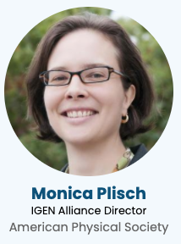
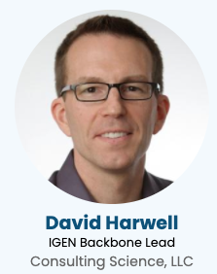
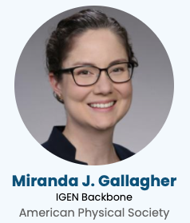

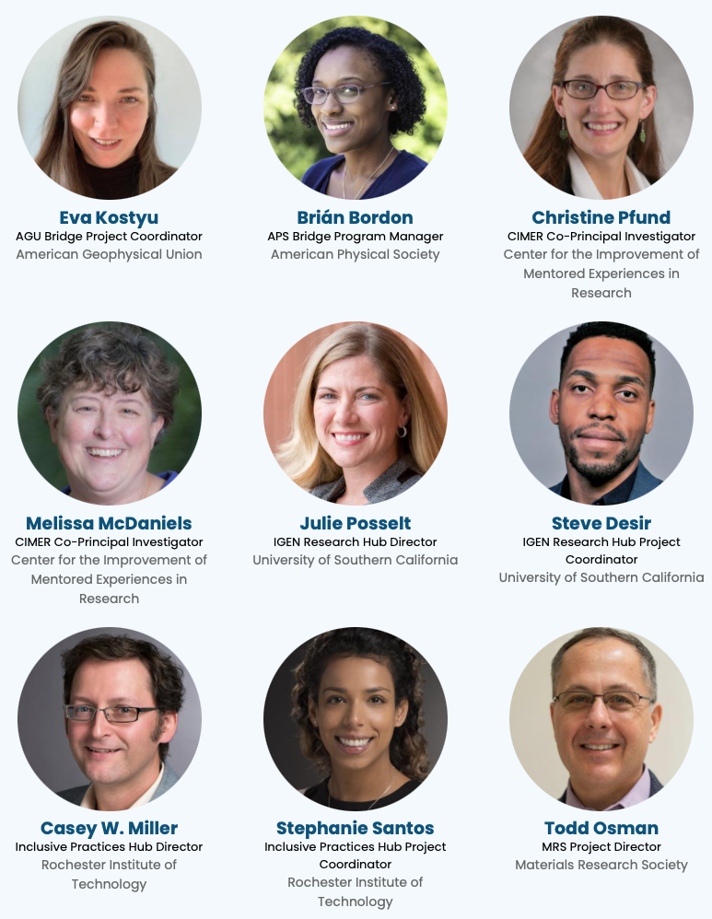
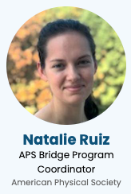


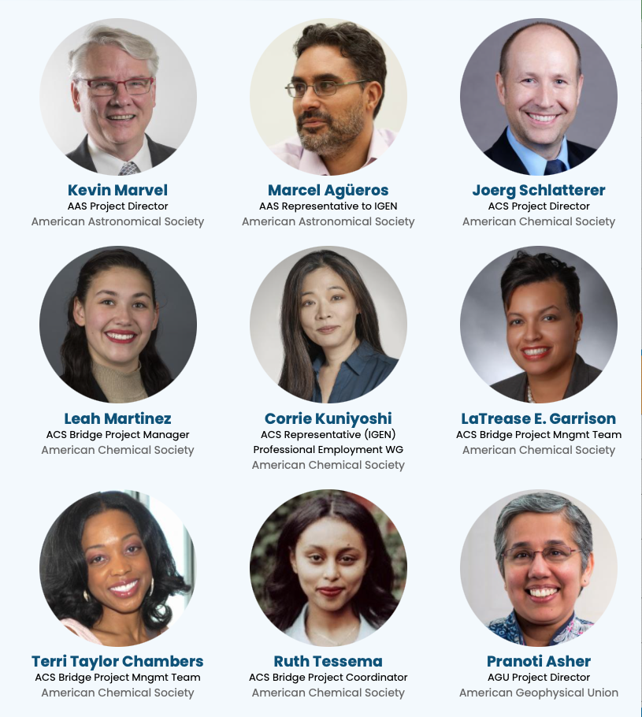


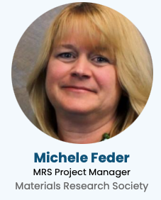



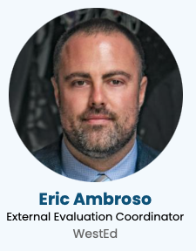
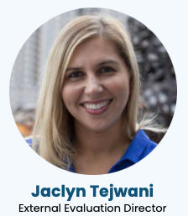

IGEN Alliance Management Team
Director
Backbone
Research Hub
Mentoring Experts
Disciplinary Societies
Inclusive Practices Hub
Evaluators

Slide 4
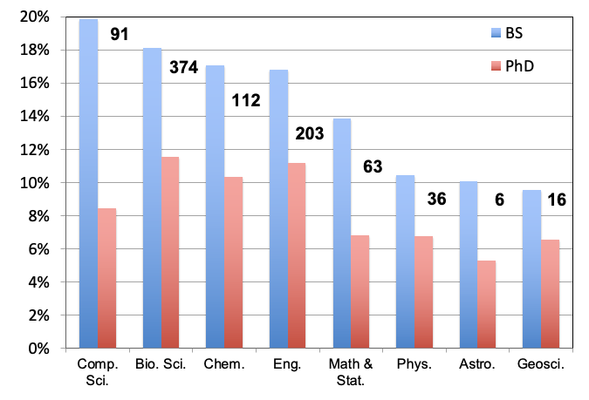
Gap between BS and PhD degree attainment
% of Black, Latinx, and Indigenous students earning degrees
Figure indicates the number of additional PhDs required to close the gap between BS and PhD degree attainment.
Source: IPEDS, 2011-2015.

Slide 5
Redesigning Graduate Admissions and Retention
Bridge Program Key Components:
National aggregation of graduate applications
Begin considerations after April 15
Recruit from all undergraduate departments
Require students to have not been accepted or not applied
Vetted departments, committed to supporting students throughout their studies
Attention to induction, flexible curriculum, constellation mentoring, progress monitoring, financial support
Notes:
Ted Hodapp

Slide 6
APS Bridge Program Outcomes
Goal: to increase the number of URM students earning a PhD in physics
Outcomes:
330+ students placed in total
Annual placements close to closing the BS-PhD gap
78% retention rate across all cohorts
14 PhD graduates to date
www.apsbridgeprogram.org

Slide 7
Some reasons students are not admitted/do not apply
Low physics GRE scores
Students apply to too few or wrong places
Students feel unprepared
Inadequate preparation in undergraduate program
Economic circumstances
Faculty have limited time to evaluate applications
Application materials do not tell a predictive story
Faculty lack awareness of admissions research
More…

Slide 8
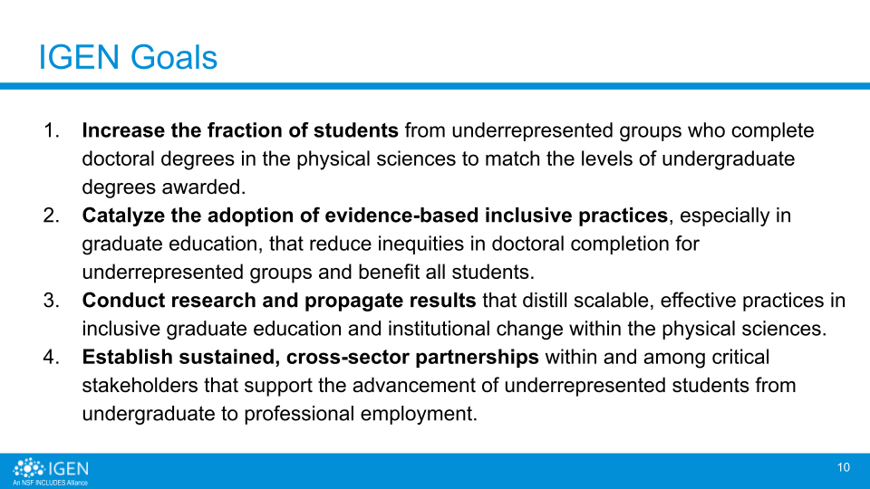
Goals

Slide 9
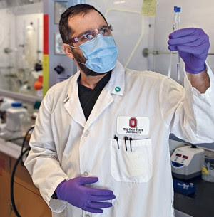
Goal 1: Increase URM PhDs in Physical Sciences
The Bridge Program gave me an opportunity to get into a PhD program for chemistry that I absolutely would not have had otherwise.
—Joe Rodriguez, PhD student, Ohio State University
New Bridge Fellows (Year 1-3) | Year 1 | Year 2 | Year 3 | Total
APS* | 47 | 53 | 37 | 137
ACS | 10 | 21 | 25 | 56
AGU | — | 7 | 18 | 25
Total | 57 | 81 | 83 | 218
* In addition, APS placed 200 Bridge Fellows before the IGEN Alliance.

Slide 10
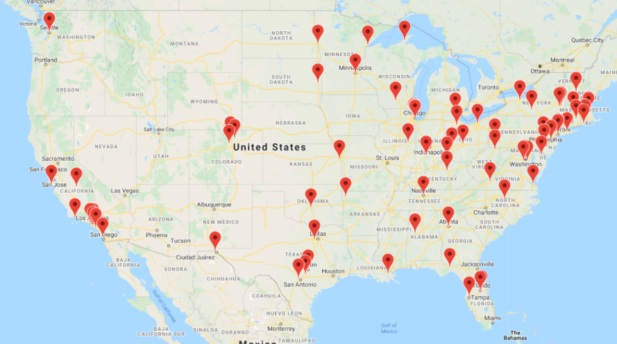
Goal 1: Increase URM PhDs in Physical Sciences
Locations of Bridge Departments
New Bridge Departments (Year 1-3) | Year 1 | Year 2 | Year 3 | Total
APS Partners* | 2 | 2 | 4 | 8
ACS Partners | 6 | 11 | 3 | 20
ACS Sites | 2 | 4** | 3 | 9
AGU Partners | — | 13 | 18 | 31
Total | 8 | 29 | 31 | 68
* APS has 32 additional Bridge Partners established before the IGEN Alliance.
** In Year 2, two ACS Bridge Partners became Bridge Sites.
Notes:
Multiple programs at same university, OSU story

Slide 11
Student Persistence and Support
81%
Bridge Student survey respondents agreed or strongly agreed that they can accomplish their academic goals in their program
Reported receiving valuable support from faculty and program staff during their graduate program
84%
Year 1&2
Retention
Rate
95%
“They [Bridge Faculty] very much gave me the sense that they care very deeply about their students and try to set them up for success, rather than to just try to filter them out. So yeah, that feeling has only been reinforced every time that I’ve had an issue. I’ve received overwhelming support from faculty.” - Bridge student
Notes:
Also mention imposter syndrome, peer support

Slide 12

Goal 2: Catalyze Inclusive Practices
Workshop Events
Holistic Graduate Admissions
Mentor Training
Graduate Student Wellbeing
Organizational Change
Facilitator Training
65+
1,700+
Workshop Participants
20+
Fields Reached
37+
Facilitators Trained
29
IGEN Bridge Departments
11
National Laboratories

Slide 13
Goal 2: Catalyze Inclusive Practices
“I know a lot about chemistry, but I'm not an expert in admissions or learning or many of the other things that are really important to evaluating best practices. I’m not conversing with that literature. So, having people who have studied it give us data is always powerful. . . . I found the data to be convincing and interesting.”
Faculty Workshop Participant

Slide 14

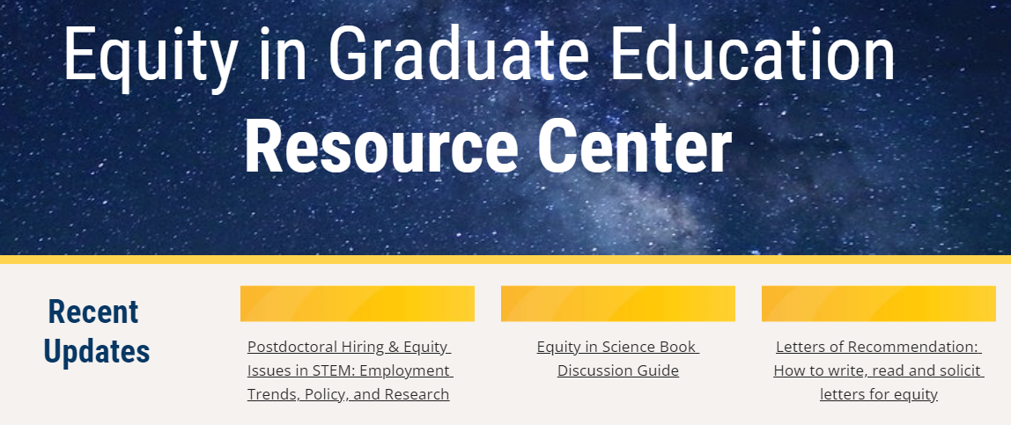
Goal 3: Conduct & Translate Research
Developed a racial equity statement
15 publications to date
500+ Participants in Virtual Journal Club meetings
Research Hub Accelerator : 5 x $5000 seed grants
Notes:
Emphasize translation work
High profile publication venues:
Nature Astronomy, Science Advances, Inside Higher Ed, Physics Magazine, …
Stanford University Press, National Academies Press
Research findings presented at society meetings for chemistry, geoscience, sociology, education, physics
Grant to date: 114 citations, 16 presentations, 15 publications, 2 books, 1 book chapter

Slide 15
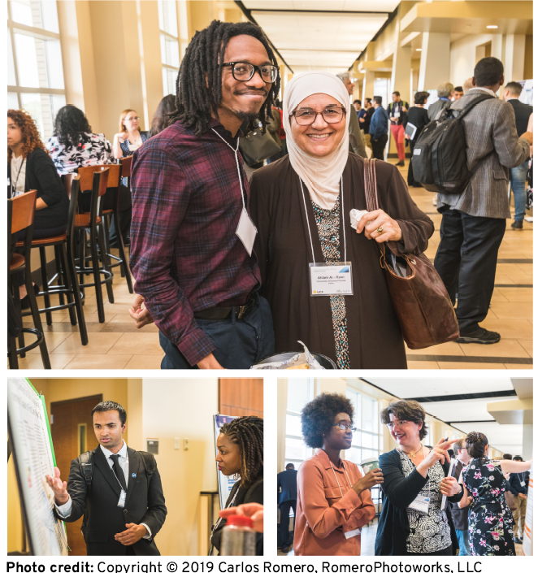
Goal 4: Establish Cross-Sector Partnerships
Virtual IGEN National Meeting attracted 200+ attendees
Society partnerships with 68 academic departments hosting Bridge Programs
Society partnerships with 4 Minority Serving Organizations
Society partnerships with 4 corporate sponsors
Professional networking group with 15 National Labs interested in recruiting Bridge students for internships and postdocs
CIMER partnership with 11 National Labs to establish a network of 27 facilitators for a mentor training curriculum
More in National Network Collaborations presentation

Slide 16
Collaborative Infrastructure - IGEN Backbone
(All) Organize AMT meetings and retreats
(All) Organize IGEN National Meeting
(SV) Organize National Advisory Board meeting
(P) Support working group meetings, activities
(P) Manage common tools and processes
(P) Provide onboarding to new members
(L&C) Help develop governance policies
(L&C) Maintain IGEN website, publish newsletter
(G&M) Facilitate relationship with evaluator
(ES&S) Liaise with potential partners
Shared Vision
Expansion, Sustainability & Scale
Partnerships
Leadership &
Communication
Goals & Metrics

Slide 17
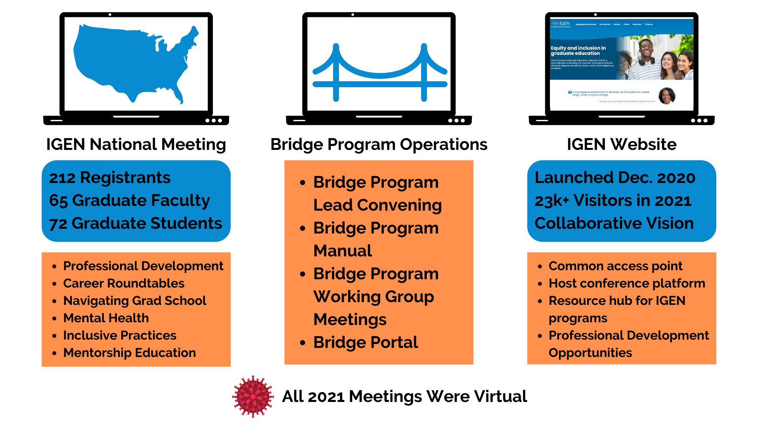
IGEN Backbone Activities

Slide 18


Shaping the National Conversation
National Academies
Graduate STEM Education for the 21st Century (Hodapp)
Science of Effective Mentoring in STEMM (Pfund)
Supporting the Whole Student: Mental Health & Wellbeing in Undergraduate and Graduate Education (Posselt)
Pathways to Discovery in Astronomy and Astrophysics for the 2020s: Panel on State of the Profession and Societal Impacts (Miller, Posselt)
White House OSTP: “The Time is Now: Advancing Equity in Science & Technology” Roundtables
Lessons from the NASEM Summit on Diversity, Equity, Inclusion & Anti-Racism in 21st Century STEMM Organizations (Posselt)
Emerging Models & Pathways for Success I: Institutional & Academic Contexts (Plisch)

Slide 19
Summary
IGEN is committed to equity in graduate education for the physical sciences
Hundreds of students gained access to graduate education through Bridge Programs, and these students are doing well
Hundreds of graduate program leaders were trained on inclusive practices, and many have adopted these inclusive practices
IGEN greatly expanded its partners, building scale and capacity
The Backbone is providing a platform for collaborative action

